Slide 1
Optimization
Professor Thomas R. Sexton, Ph.D.
College of Business
Stony Brook University

Slide 2
Optimization
The action of making the best or most effective use of a situation or resource.
We all do it, every day:
  Shortest route to our destination
  Least expensive item that meets our needs
  Fastest way to finish our undesirable tasks
Organizations do it:
  Cheapest way to produce and transport its products
  Price to charge to maximize profit
  Smallest work force that gets the job done

Slide 3
Components of an Optimization Problem
Decision variables: The things we can select.
Objective function: What we want to minimize or maximize.
Constraints: Restrictions on what we must or cannot do.

Slide 4
Route to Our Destination
Decision variables: The transportation alternatives:
  Mode of transportation (car, plane, bus, boat …)
  Specific route to follow
Objective function: What we want to minimize or maximize.
  Distance travelled
  Travel time
  Cost
Constraints: Conditions that must be met.
  Earliest departure time
  Latest arrival time
  Available money

Slide 5
Buying a Car
Decision variables: The available cars
Objective function: What we want to minimize or maximize.
  Cost
  Style
  Fuel efficiency
Constraints: Conditions that must be met.
  Functionality (number of seats, towing capacity, etc.)
  Available money

Slide 6
Mowing the Lawn
Decision variables: The alternatives:
  Do it yourself
  Hire a neighborhood kid
  Hire a professional landscaper
Objective function: What we want to minimize or maximize.
  Cost
  Time to completion
Constraints: Conditions that must be met.
  Keep wife happy
  Number of kids in the neighborhood
  Available money

Slide 7
Workforce Management
Maintenance at a large theme park goes on 24 hours/day.
Maintenance personnel work 8-hour shifts starting every 4 hours.
The minimum number of workers needed during each period:
Period | Minimum Number of Workers
12 AM to 4 AM | 90
4 AM to 8 AM | 215
8 AM to 12 PM | 250
12 PM to 4 PM | 165
4 PM to 8 PM | 300
8 PM to 12 AM | 125

Slide 8

Here’s the Problem
How many workers should work each shift to minimize the total number of workers?
Objective function: Minimize $Z=\sum_{i=1}^{6}{X_{i}}$
Shift | Number of Workers
12 AM to 8 AM | X₁
4 AM to 12 PM | X₂
8 AM to 4 PM | X₃
12 PM to 8 PM | X₄
4 PM to 12 PM | X₅
8 PM to 4 AM | X₆
Decision Variables

Slide 9
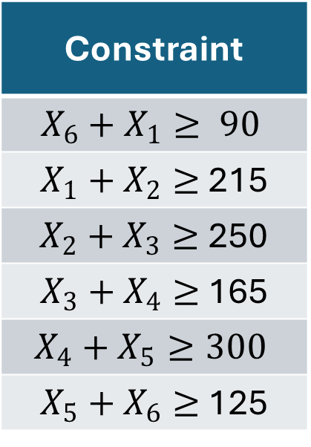
Constraints
Period | Minimum Number of Workers
12 AM to 4 AM | 90
4 AM to 8 AM | 215
8 AM to 12 PM | 250
12 PM to 4 PM | 165
4 PM to 8 PM | 300
8 PM to 12 AM | 125
Constraint
$$X_{6}+X_{1}≥ 90$$
$X_{1}+X_{2}≥$ 215
$X_{2}+X_{3}≥$250
$X_{3}+X_{4}≥$ 165
$$X_{4}+X_{5}≥300$$
$X_{5}+X_{6}≥$ 125

Slide 10
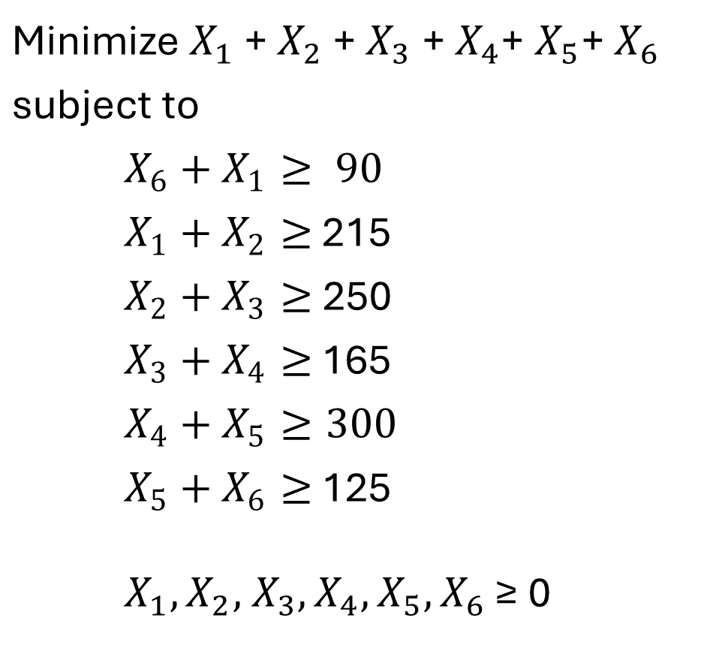
Linear Programming Formulation
Minimize $X_{1}$ +${ X}_{2} \text{+} X_{3}$ +${ X}_{4}\text{+} X_{5}\text{+} X_{6}$
subject to
$$X_{6}+X_{1}≥ 90$$
$X_{1}+X_{2}≥$ 215
$X_{2}+X_{3}≥$250
$X_{3}+X_{4}≥$ 165
$$X_{4}+X_{5}≥300$$
$X_{5}+X_{6}≥$ 125 $X_{1},X_{2}\text{,} X_{3},X_{4},X_{5}{,X}_{6}$ ≥ 0

Slide 11
Your Assignment:
What are the optimal values of the decision variables?
How many workers should start their 8-hour shift at each of the six possible starting times?
How many maintenance workers does the theme park need to employ?

